Slide 1
Austin vs. San Francisco: A Comparison of Two Tech Hubs
Chandini Ramesh

Slide 2
Introduction
Two of the largest hubs for technology companies
Many techies have been recently relocating to Austin
Should I do the same?

Slide 3
Data Description
The following data was collected for the analysis:
Austin population data from government census
San Francisco population data from government census
Foursquare API to get most common venues in Austin and San Francisco

Slide 4


Methodology
Analyze population data for both Austin and San Francisco

Slide 5


Methodology (cont.)

Slide 6
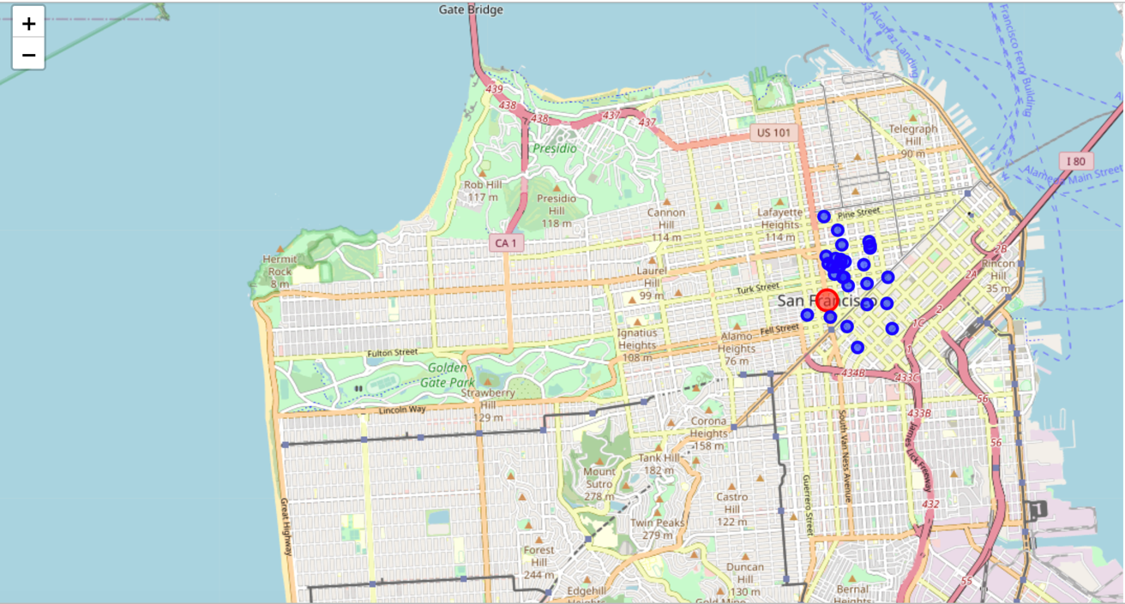
Results

Slide 7
Results

Slide 8
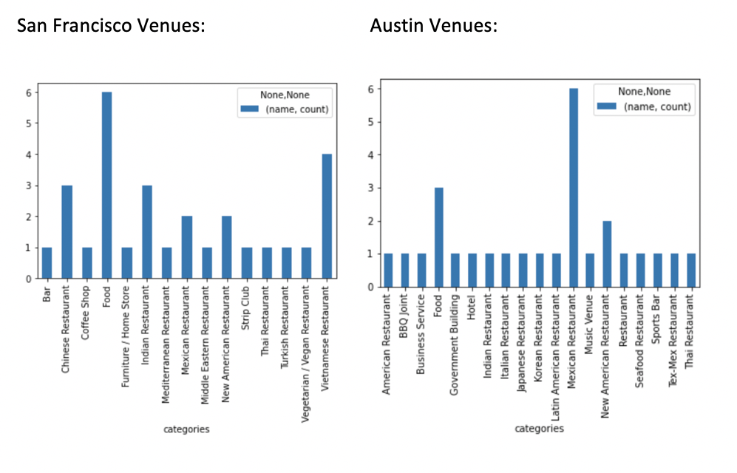
Results

Slide 9
Conclusion
Only two factors on which to compare a city
Other potential factors could be:
Weather
Job opportunities
Real Estate Prices
Based on the two factors I looked at: cities are similar!

